Slide 1

Detecting Fraudulent Credit Card Transactions
Steven Gonzales | Evan Peraza | Weihao Liu Yongkang Liu | Ramon Ulloa

Slide 2

Goals:
Use transaction data to build anomaly detection models that could allow us to detect and flag fraudulent credit card activity.

Slide 3
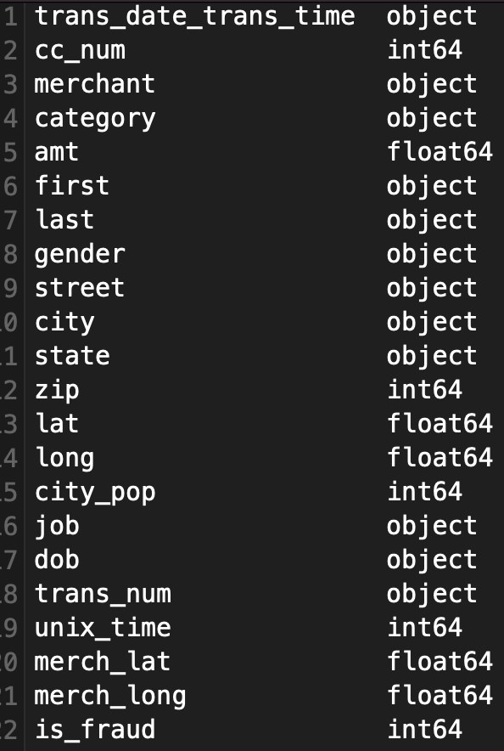
About the Dataset:
Contains anonymized credit card transactions, the data is simulator generated, each entry labeled as either fraudulent or non-fraudulent.
The data includes numerical features derived from the source’s information to protect privacy.
These features help identify patterns and relationships for fraud detection.
The dataset is pre-divided into training and testing files, making it suitable for machine learning tasks like anomaly detection. It is commonly used to test models that handle imbalanced data, as fraud cases are much rarer than normal transactions.

Slide 4

Project Requirements
Data Requirements
Tools and Technologies
Credit card transaction dataset with labeled information.
Programming language (i.e. Python)
Libraries: Pandas, NumPy, Matplotlib, Scikit-learn, TensorFlow, PyOD, Isolation Forest.
Environment: Jupyter Notebook
Hardware
Local machine with enough processing power to handle large datasets if needed.

Slide 5
Algorithms Overview
Identity the most effective algorithm for use with fraud detection:
Decision Tree Classifier
Isolation Forest
Random Forest Classifier
Gaussian Naive Bayes Classifier
K-means Clustering
Logistic Regression
KNN
The rare cases of fraud made the nature of the data complex and imbalanced. We experimented with different machine learning algorithms to balance accuracy, robustness, and to handle the data complexity.

Slide 6

Preprocessing data
Manual Encoding
Apply binary code for certain categories (Gender: M=1, F = 0)
Prepares the raw data to ensure that it is consistent, not missing any values, and has relevant information for processing
One-hot encoding
Assigns a unique integer to a category in a feature.
Label Encoding
Converts category variables into numerical values.

Slide 7
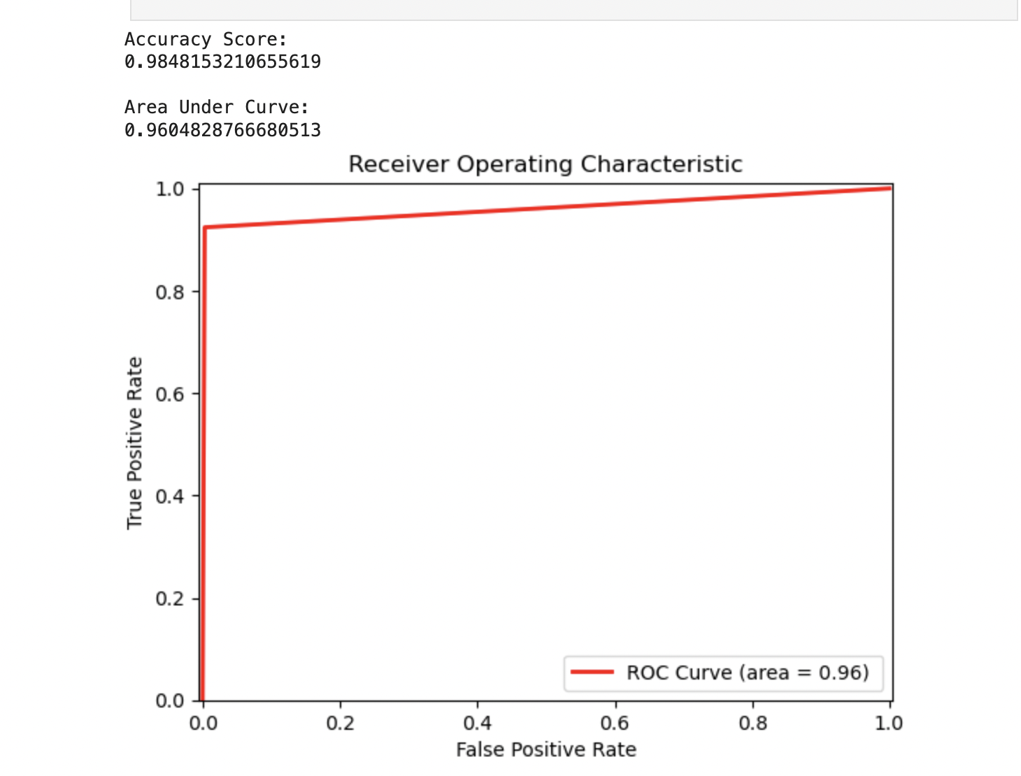
Decision Tree Classifier
Splits dataset into values, creating nodes that represent decisions in the tree.
Accuracy Score: 98.48%
Model performed well for identifying credit card fraud
Area Under Curve (AUC): 96.05%
High AUC demonstrates that the model was able to distinguish between fraud and non-fraud cases.

Slide 8
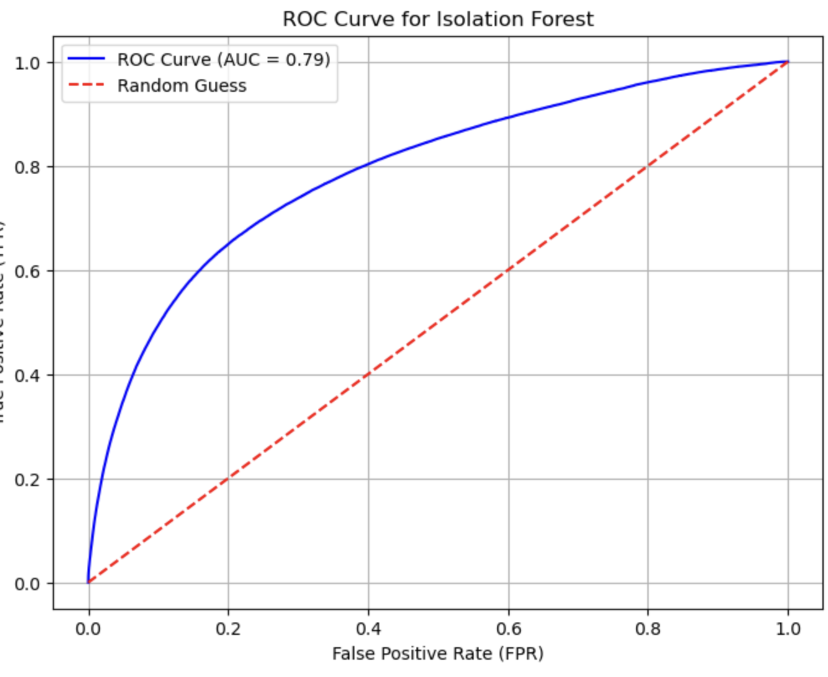
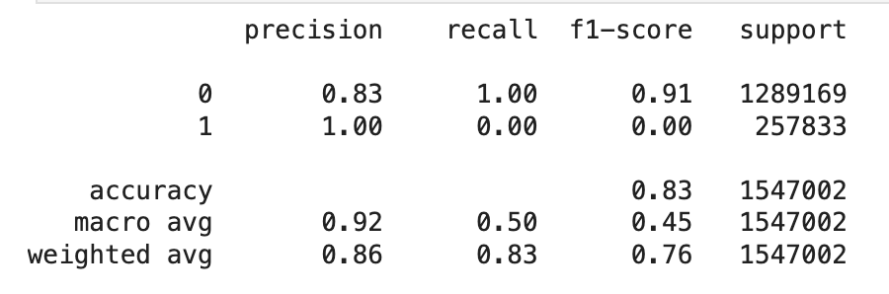
Isolation Forest
Unsupervised anomaly detection algorithm that
isolates outliers by randomly dividing data.
Recall for fraud detection is 0, meaning model could not detect fraud.
Area Under Curve: 79%
Model struggles with separation of fraud and non fraud transactions.

Slide 9
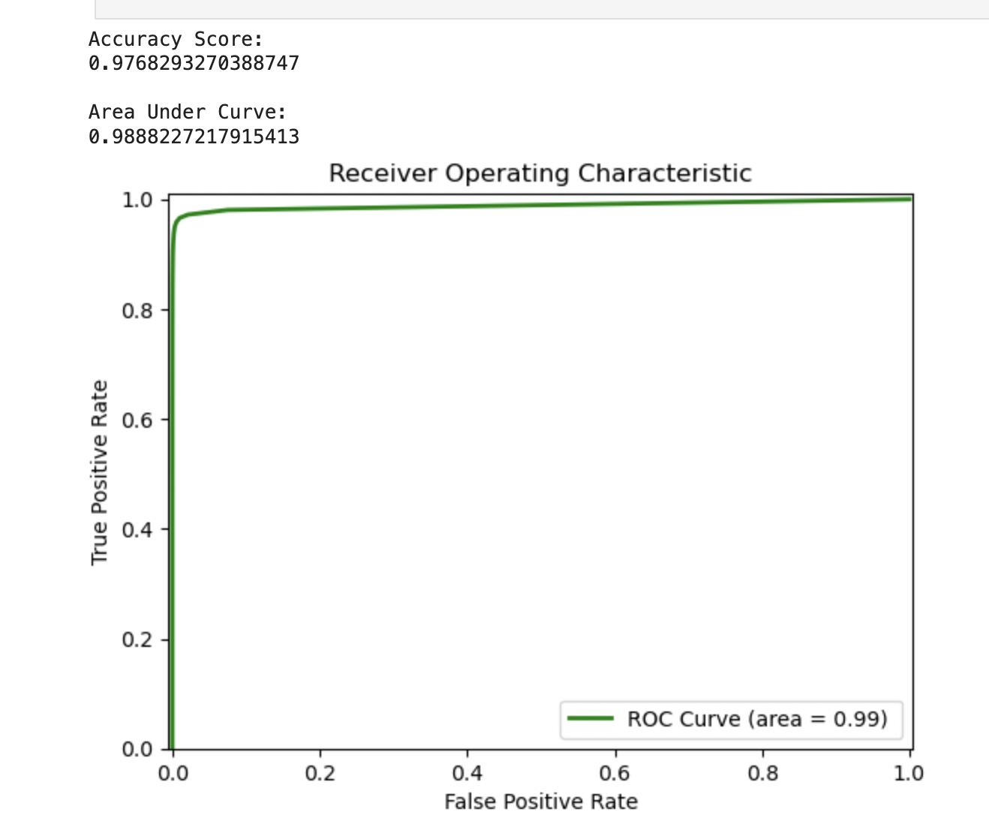
Random Forest Classifier
Combines predictions from multiple decision trees to classify data. Makes use of ensemble learning approach for high accuracy yield.
Accuracy score: 97.68%
Model Performed 0.8% worse than the Decision Tree (overfitting).
Area Under Curve (AUC): 98.88
Model outperformed Decision Tree classifier for distinguishing between fraud and non fraud cases.

Slide 10
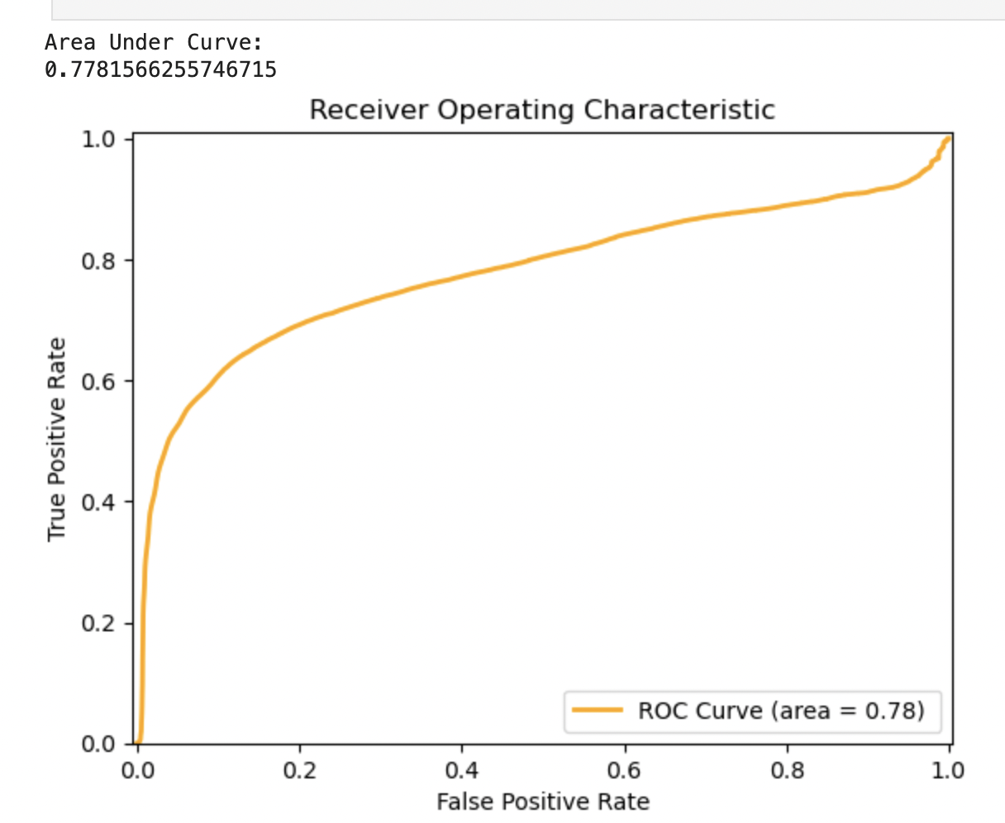
Gaussian Naive Bayes Classifier
Probabilistic classifier that assumes all the features are independent and that the data follows a normal (Gaussian) distribution.
Accuracy Score: 88.40%
Performs worse than Decision Tree and Random forest due to the simplistic approach and assumptions of data (i.e. independent, normal).
Area Under Curve: 77.82%
Difficulty with complex data sets and non-normal (Gaussian) features.

Slide 11
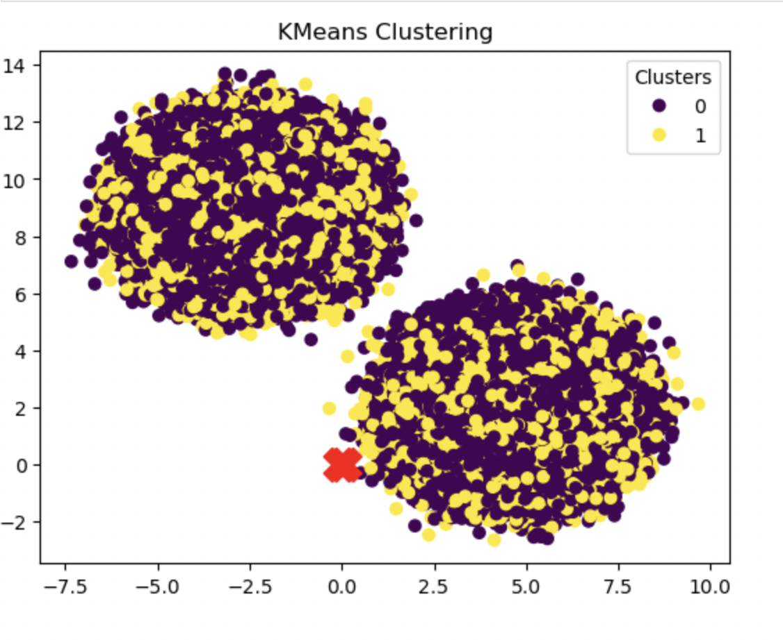
K-Means Clustering
K-Means Clustering groups data points by their similarity, forming clusters with minimal internal variation. Each cluster is defined by a centroid, representing the center of that group.
Accuracy Score: 58.55%
K-means struggles with complex data, due to its assumption of spherical clustering.
It is unsupervised, meaning does not require labels. This can limit its ability to detect anomalies in imbalanced data

Slide 12
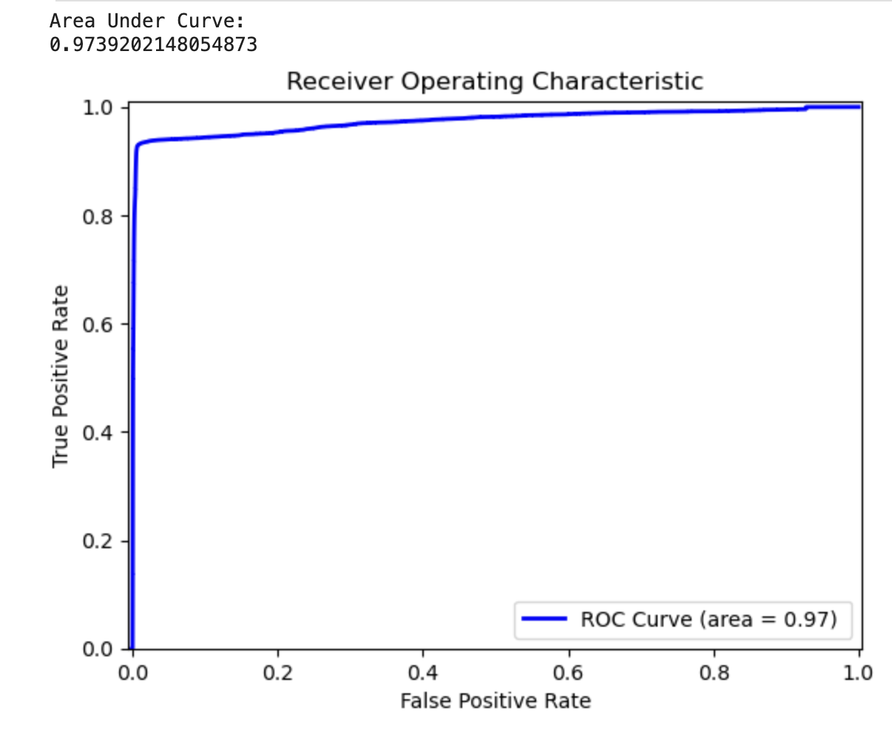
Logistic Regression
A linear model that finds that best-fit for a dataset. Used as a predictive model based on relationship of independent and dependent variables.
Accuracy Score: 96.91%
Performed well given the simplistic approach to complex data. Assumes a linear relationship between features, and variables.
Area Under Curve: 97.39%
Simple approach shows that even complex data can align with algorithms assumptions.

Slide 13
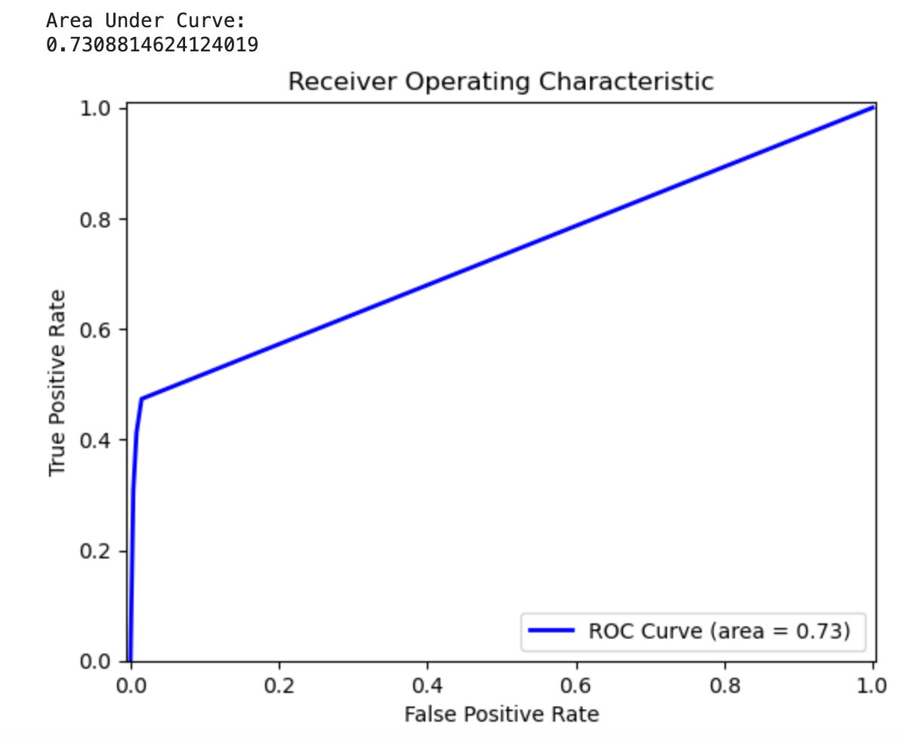
KNN
K-Nearest Neighbor is a simple algorithm that classifies data points based on their similarity to their closet k neighbor.
Computationally intensive with large data. We were unable to run the algorithm in a reasonable amount of time without first reducing the feature set by use of PCA
Accuracy Score: 89.53%
Good accuracy but does not fully detect fraud as compare to other models.
Area Under Curve: 73.09%
Model struggles with fraud detection, even after dimensionality reduction via PCA.

Slide 14
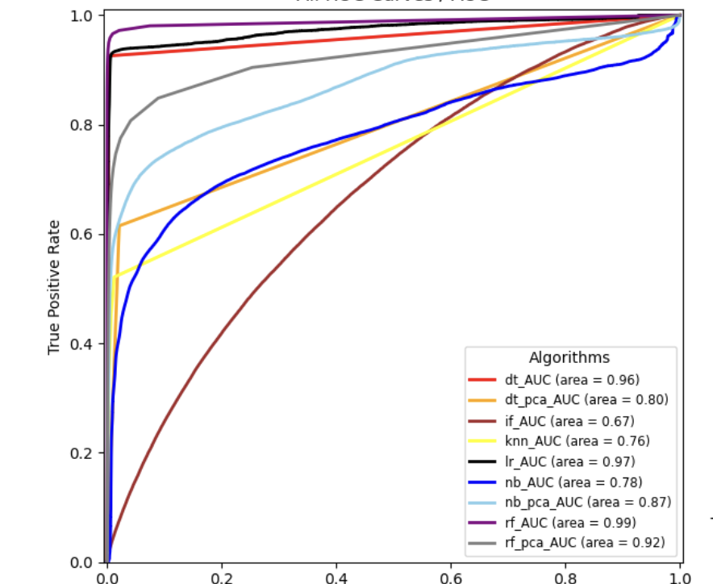
All ROC Curves
Overlay of all the aforementioned algorithms shows the varying results.
The best performer from this dataset is Random Forest Classifier:
Combines the decisions from multiple decision trees.
Able to handle noise and overfitting.
Can scale well with large datasets and complexity.

